Slide 1
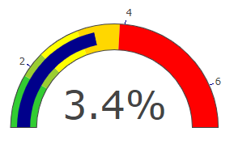
Participation in education and training
Proportion in education and training
Type of education or training
Region
England
96.0%
Annual change in LA ET –x.xppts
Annual change in London ET –x.xppts
Annual change in England ET –x.xppts
September Guarantee: % offered an education place
Region
England
Annual change in LA offers –x.xppts
Annual change in London offers –x.xppts
Annual change in England offers –x.xppts
97.0%

